Slide 1
RISK
Notes from Somerville, Ch9

Slide 2
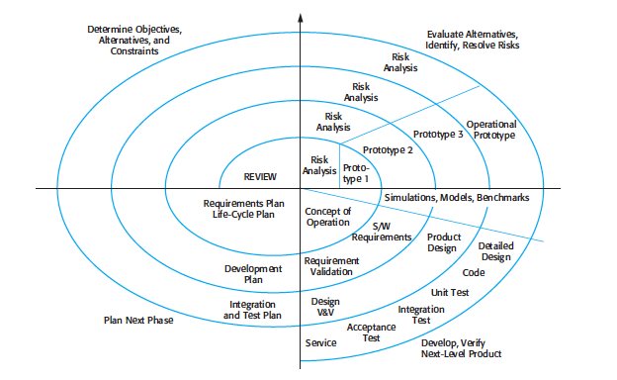
Spiral Model (Boehm)

Slide 3
Spiral Somerville (9th ed)
1 Objective Setting
Define objectives
Identify Constraint
Create management plan
Identify risks and alternative strategies
2 Risk assessment and reduction
Detailed analysis
Develop prototypes
3 Development and Validation
Choose development model
Interface risks, safety risks integration risks
4 Planning
Review, plan next phase

Slide 4
Types of Risk
Project Risks
Schedule, resources, los of experienced designer
Product Risks
Quality or performance. E.g. Purchased subsystem has low performance
Business risks
Competitor introduces new system

Slide 5
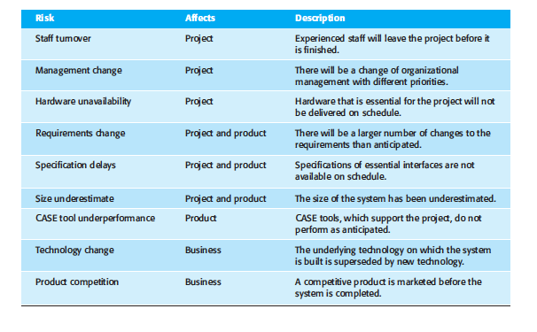
Types - detail

Slide 6
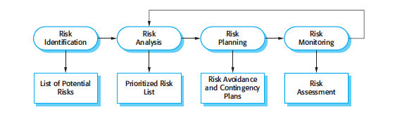
Risk Management

Slide 7
Risk Identification
Technology: Hardware or software used
People: development team
Organizational: Corporate environment
Tools: tools and support software
Requirements: Managing requirements change
Estimation: management estimates

Slide 8
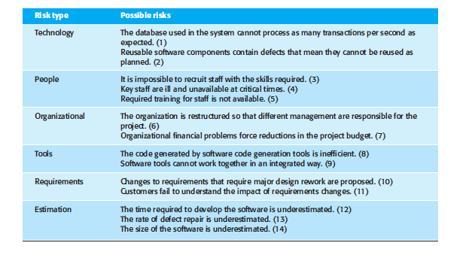
Examples of Types of Risk

Slide 9
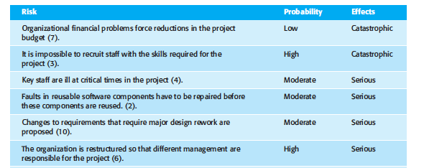
Risk Types-1

Slide 10
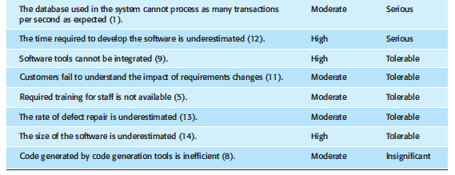
Risk Types-2

Slide 11
Types of Strategy
Avoidance: strategies for dealing with defective components
Minimization: strategy for employee illness
Contingency: strategy for financial problems

Slide 12
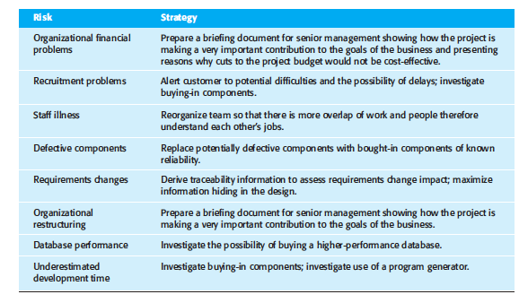
Risk Management

Slide 13
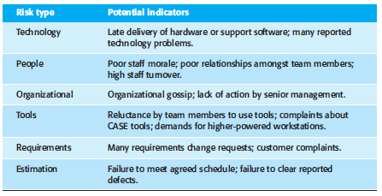
Risk indicators

